Slide 1
Automating the Extraction of Genealogical Information from Historical Documents
Aaron P. Stewart
David W. Embley
March 20, 2011

Slide 2
Part I: Vision
Current projects at the BYU Data Extraction Group

Slide 3
Problem: Enable users to search for facts and implied facts contained historical documents
Motivation: Genealogy
Solution:
  Scan & OCR historical docs (e.g., The Ely Ancestry)
  Extract facts (e.g., OntoES) along with keywords and index them for fast search (e.g., HyKSS)
  Define inference rules (Nathan’s work), process them and index them (HyKSS)
  Free-form and form-based queries
    Results of queries displayed
    Results “clickable”: highlights and displays extracted facts on page where results were obtained and for any inference rules used, displays the reasoning chain
Implementation Status & Hard Problems to Solve

Slide 4
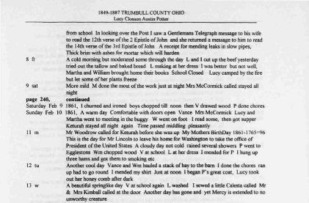
Goal: Search books for names
History of the Jones Family
George Jones
scanner

Slide 5
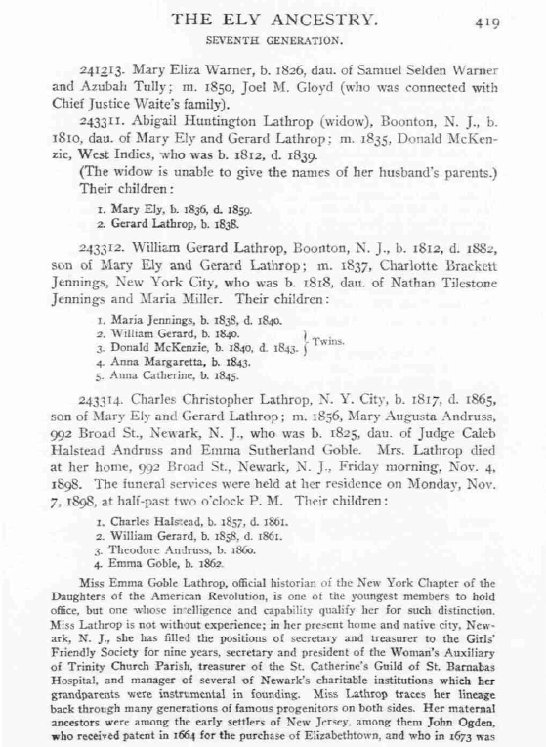
Original Document

Slide 6
Original Document

Slide 7
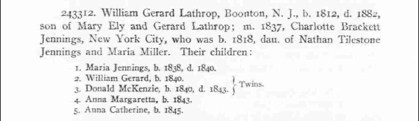
Original Document

Slide 8
Extracted Facts
Relationships
William Gerard Lathrop : son of : Mary Ely
William Gerard Lathrop : son of : Gerard Lathrop
William Gerard Lathrop : m. : Charlotte Brackett Jennings
Charlotte Brackett Jennings : dau. of : Nathan Tilestone Jennings
Charlotte Brackett Jennings : dau. of : Maria Miller
Names
William Gerard Lathrop
Mary Ely
Gerard Lathrop
Charlotte Brackett Jennings
Nathan Tilestone Jennings
Maria Miller
Maria Jennings [Lathrop]
Donald McKenzie [Lathrop]
Anna Margaretta [Lathrop]
Anna Catherine [Lathrop]
Relationships (continued)
Maria Jennings : child of : William Gerard Lathrop
Maria Jennings : child of : Charlotte Brackett
William Gerard : child of : William Gerard Lathrop
William Gerard : child of : Charlotte Brackett
Donald McKenzie : child of : William Gerard Lathrop
Donald McKenzie : child of : Charlotte Brackett
Anna Margaretta : child of : William Gerard Lathrop
Anna Margaretta : child of : Charlotte Brackett
Anna Catherine : child of : William Gerard Lathrop
Anna Catherine : child of : Charlotte Brackett

Slide 9
Inferred Facts
Relationships
William Gerard Lathrop : son of : Mary Ely
William Gerard Lathrop : son of : Gerard Lathrop
William Gerard Lathrop : m. : Charlotte Brackett Jennings
Charlotte Brackett Jennings : dau. of : Nathan Tilestone Jennings
Charlotte Brackett Jennings : dau. of : Maria Miller
Names
William Gerard Lathrop
Mary Ely
Gerard Lathrop
Charlotte Brackett Jennings
Nathan Tilestone Jennings
Maria Miller
Maria Jennings [Lathrop]
Donald McKenzie [Lathrop]
Anna Margaretta [Lathrop]
Anna Catherine [Lathrop]
Relationships (continued)
Maria Jennings : child of : William Gerard Lathrop
Maria Jennings : child of : Charlotte Brackett
William Gerard : child of : William Gerard Lathrop
William Gerard : child of : Charlotte Brackett
Donald McKenzie : child of : William Gerard Lathrop
Donald McKenzie : child of : Charlotte Brackett
Anna Margaretta : child of : William Gerard Lathrop
Anna Margaretta : child of : Charlotte Brackett
Anna Catherine : child of : William Gerard Lathrop
Anna Catherine : child of : Charlotte Brackett
Inferred Relationships
Maria Jennings : grandchild of : Mary Ely
Maria Jennings : grandchild of : Gerard Lathrop
Maria Jennings : grandchild of : Nathan Tilestone Jennings
Maria Jennings : grandchild of : Maria Miller
William Gerard : grandchild of : Mary Ely
William Gerard : grandchild of : Gerard Lathrop
William Gerard : grandchild of : Nathan Tilestone Jennings
William Gerard : grandchild of : Maria Miller
…

Slide 10
Keywords
Chief Justice

Slide 11
Queries
Is there a chief justice related to Mary Ely?
Who are the sons of Gerard Lathrop?
Who are the grandchildren of Mary Ely?

Slide 12
Part II: Implementation

Slide 13
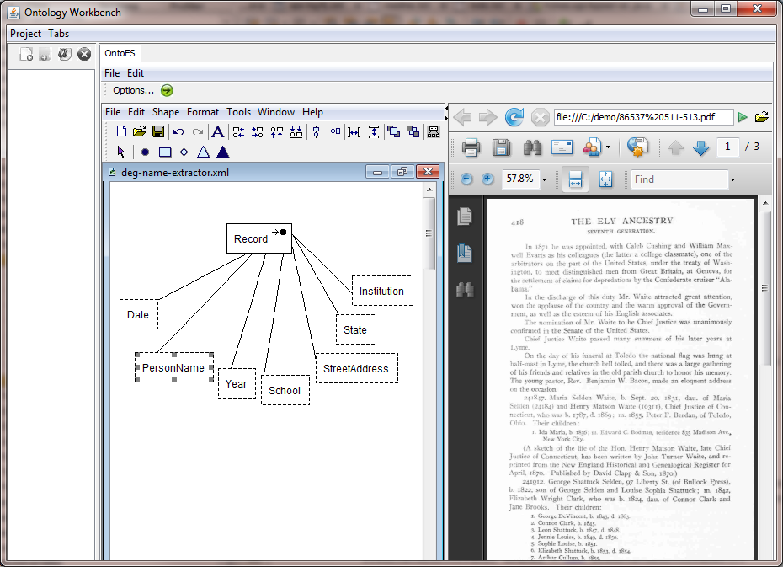
Ontology Editor

Slide 14
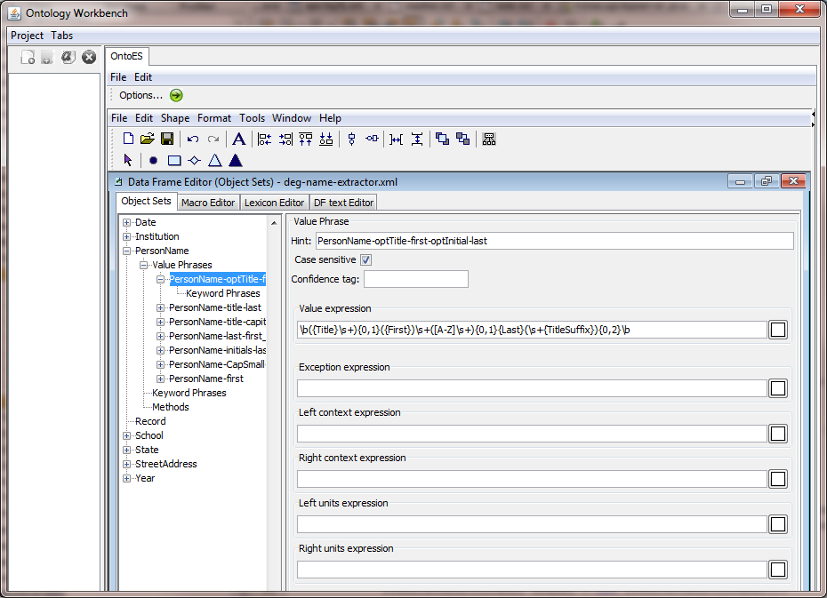
Data Frame Editor

Slide 15
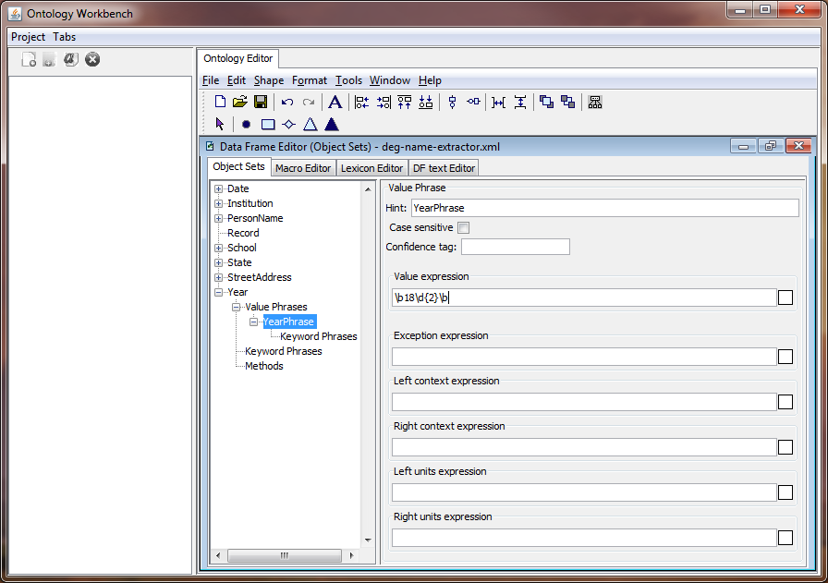
Data Frame Editor

Slide 16
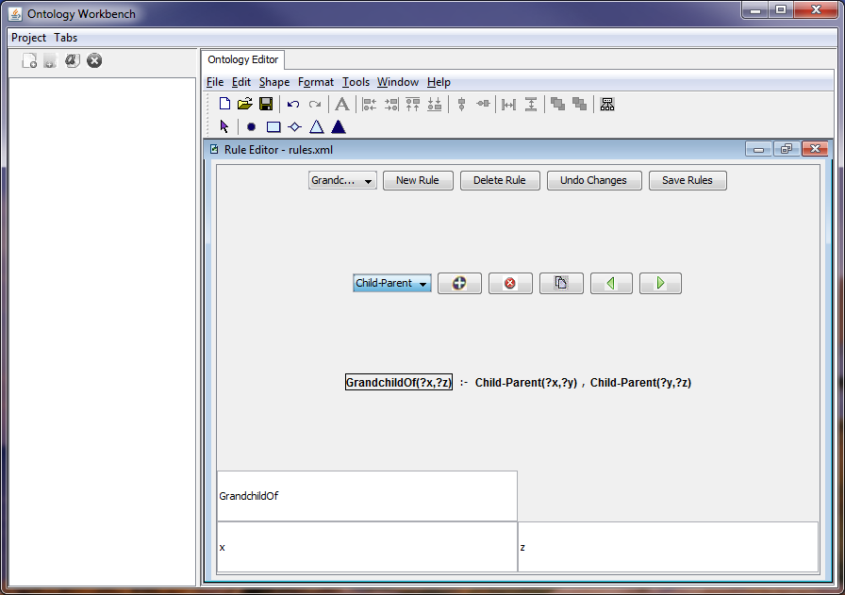
Rule Editor

Slide 17
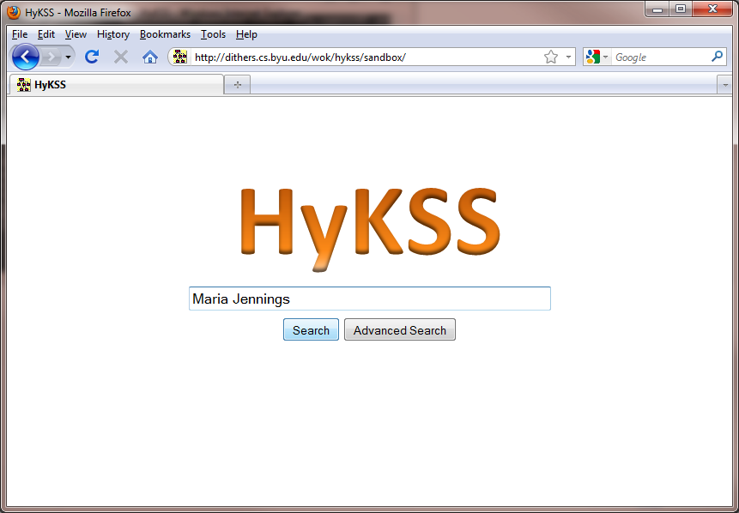
Name Query

Slide 18
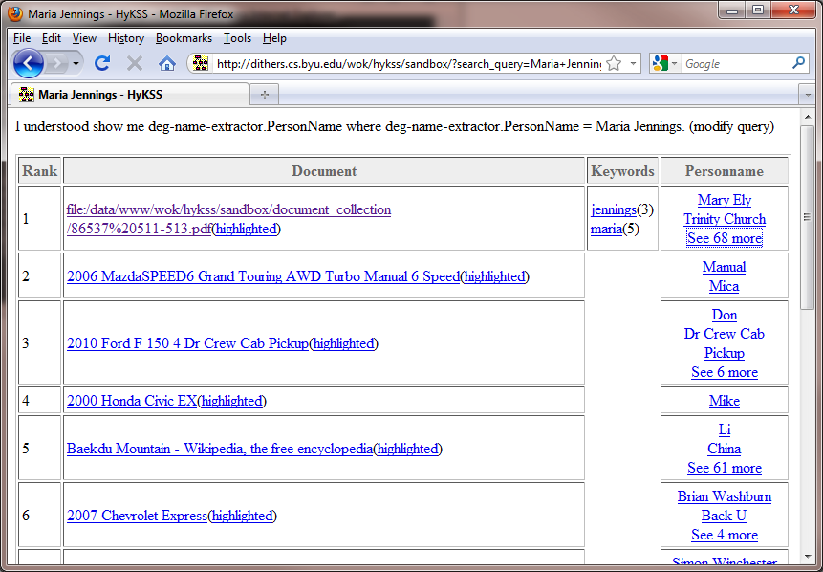
Name Query

Slide 19
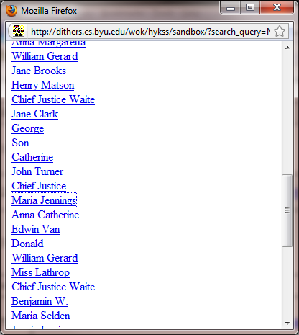
Name Query

Slide 20
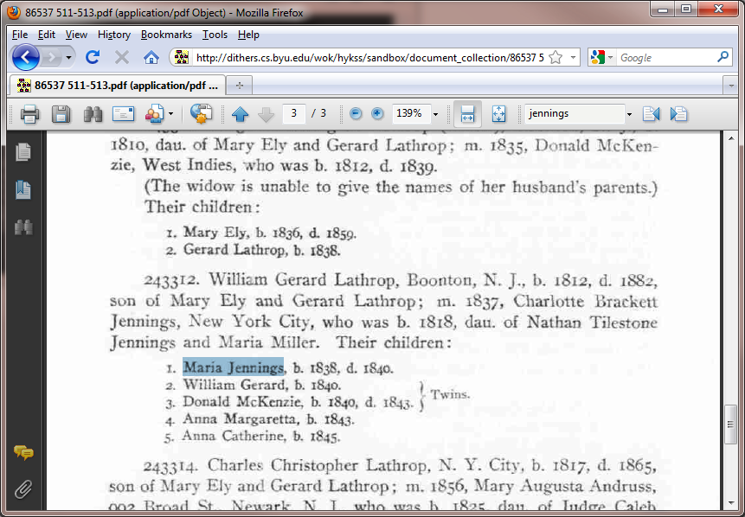
Name Query

Slide 21
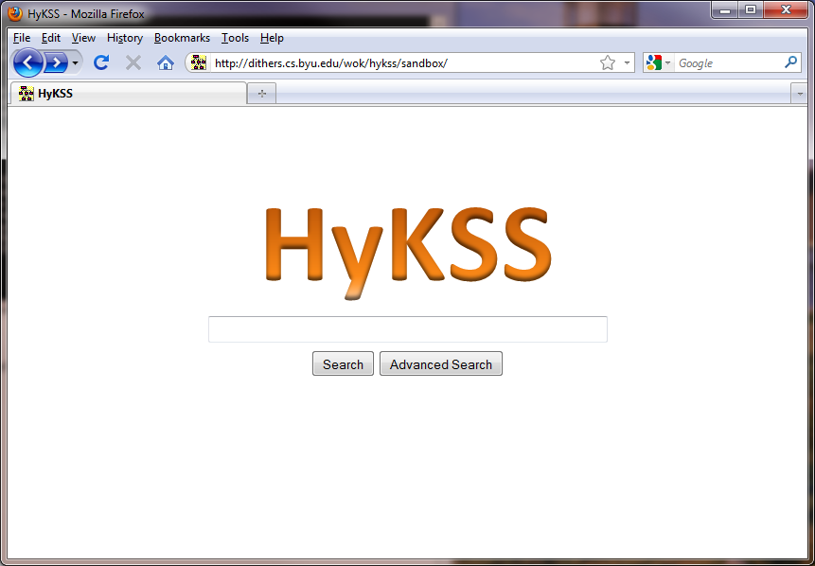
HyKSS Indexing

Slide 22
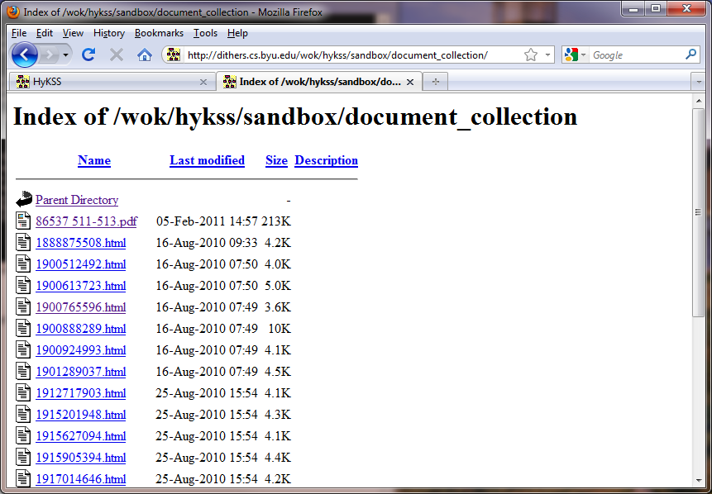
HyKSS Indexing

Slide 23
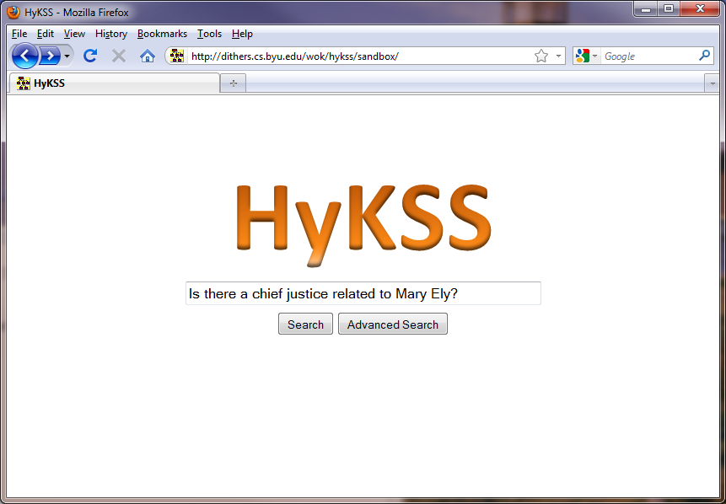
Keyword Search

Slide 24
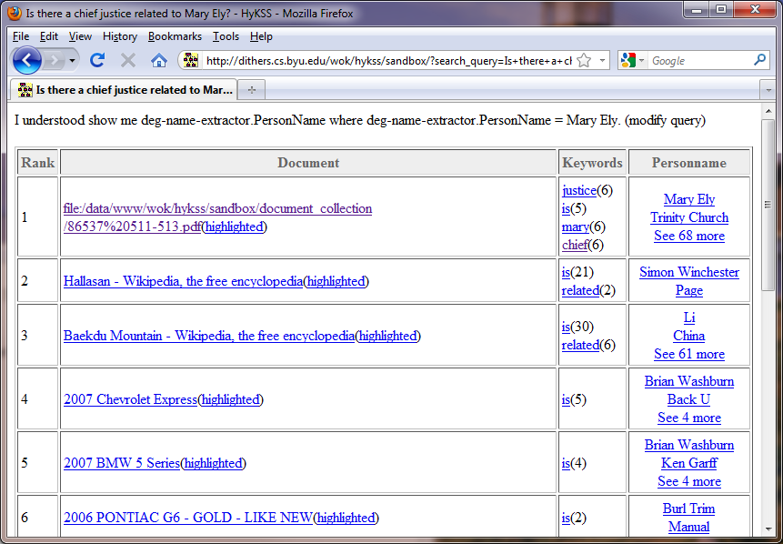
Keyword Search

Slide 25
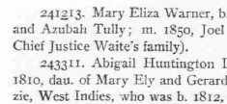
Keyword Search

Slide 26
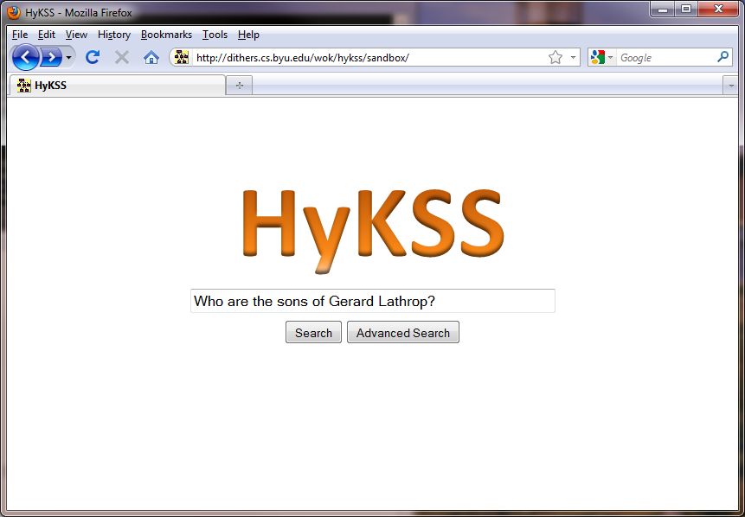
Relationship Search

Slide 27
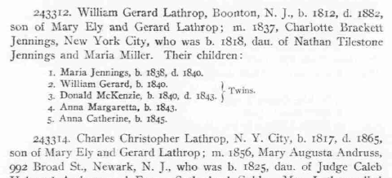
Relationship Search

Slide 28
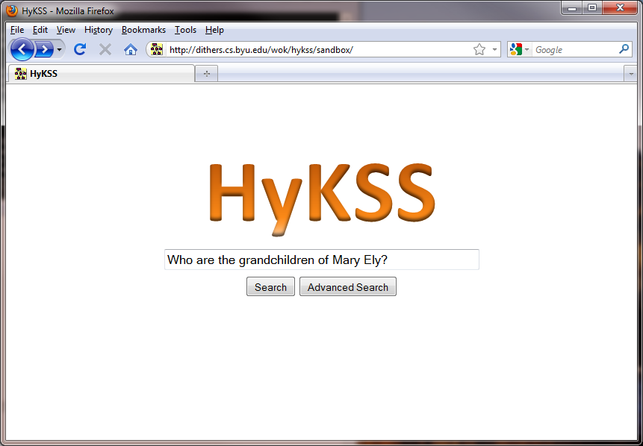
Inferred Relationship Search

Slide 29
Inferred Relationship Search
Maria Jennings is a grandchild of Mary Ely
GrandchildOf(Maria Jennings, Mary Ely) :-
Child-Parent(Maria Jennings, William Gerard Lathrop),
Child-Parent(William Gerard Lathrop, Mary Ely)

Slide 30
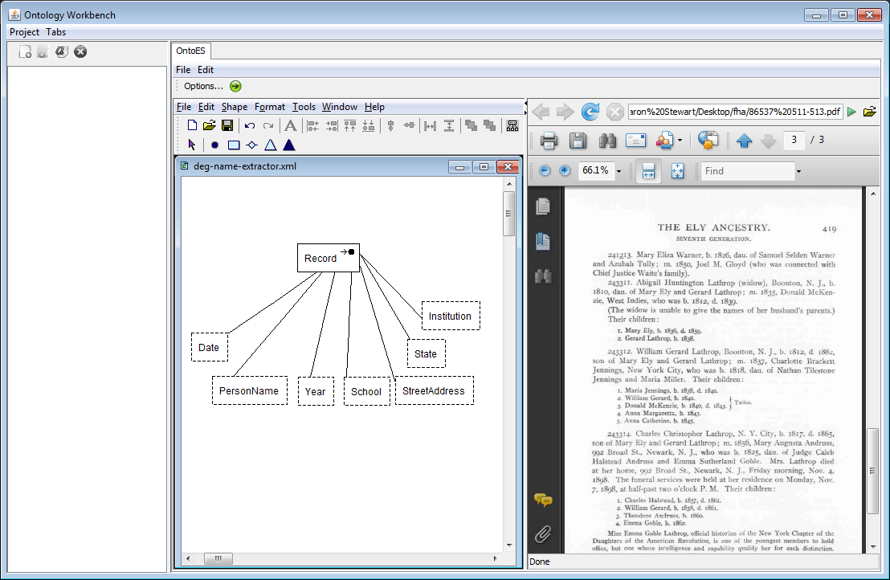
Inferred Relationship Search
Who are the grandchildren of Mary Ely?
PersonName
☑ Maria Jennings
□ William Gerard
☑ Donald McKenzie
□ Anna Margaretta
□ Anna Catherine

Slide 31
Part III: Improvements

Slide 32

Challenges in Name Extraction
http://media.photobucket.com/image/square%20peg%20in%20a%20round%20hole/HappyHeartKE/square_peg_in_round_hole_2.jpg?o=4

Slide 33
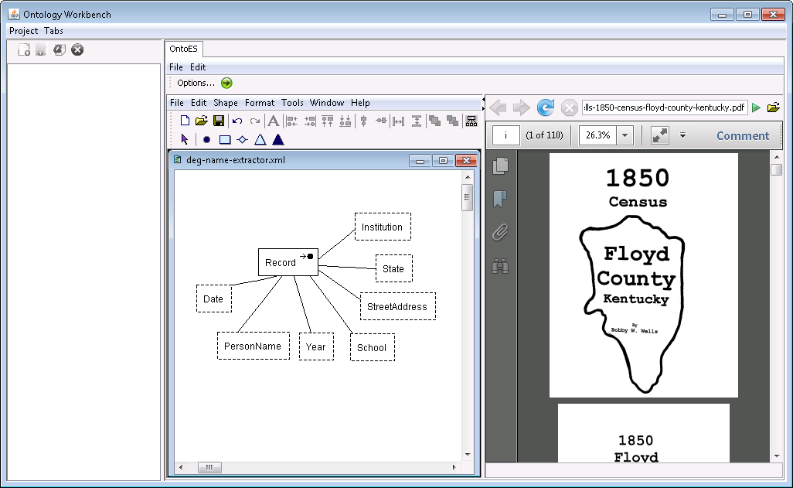
Extraction Tools

Slide 34
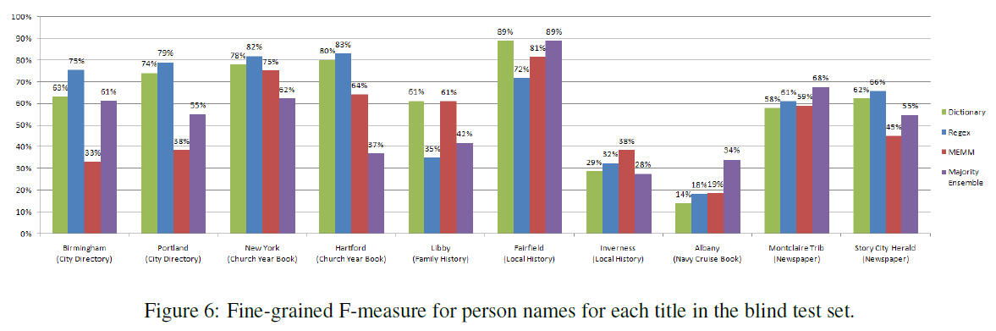
Need Better Extraction Results
------- Lists -------
From Packer et al., http://deg.byu.edu/papers/Ancestry_NAACL_HLT_Paper.pdf

Slide 35
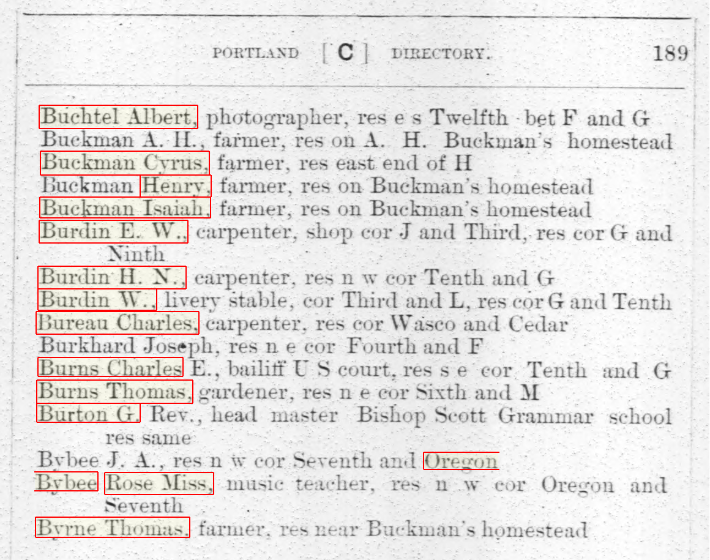
Example of a Better Extractor
(Margin Finder)
Buekman (OCR error)
Baseline errors
Uuckkman (OCR error)
Jobsph (OCR error)
Charles. (OCR error)
B\ liee (OCR error)
Baseline errors

Slide 36
Example of a Better Extractor
(Margin Finder)
LEVEL 1
LEVEL 1
LEVEL 1
LEVEL 1
LEVEL 1
LEVEL 1
LEVEL 2
LEVEL 1
LEVEL 1
LEVEL 1
LEVEL 1
LEVEL 1
LEVEL 1
LEVEL 1
LEVEL 2
LEVEL 1
LEVEL 1
LEVEL 2
LEVEL 1

Slide 37
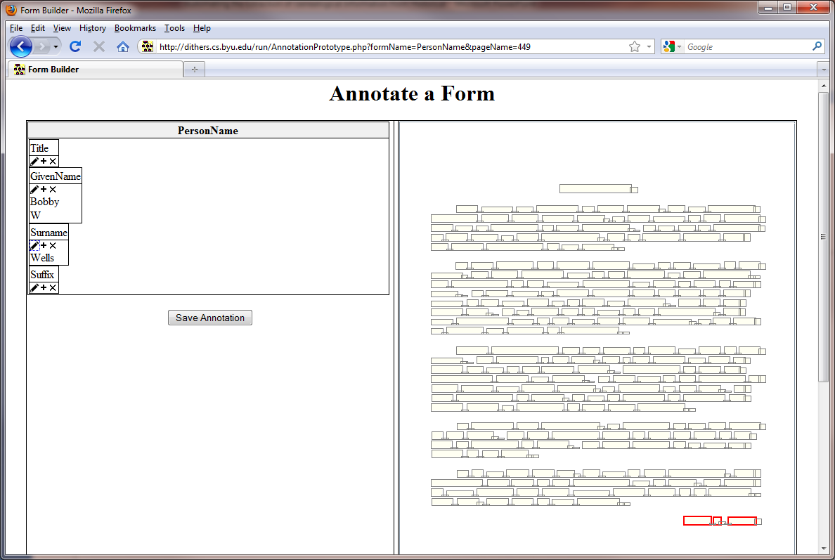
Need Annotation Tools

Slide 38
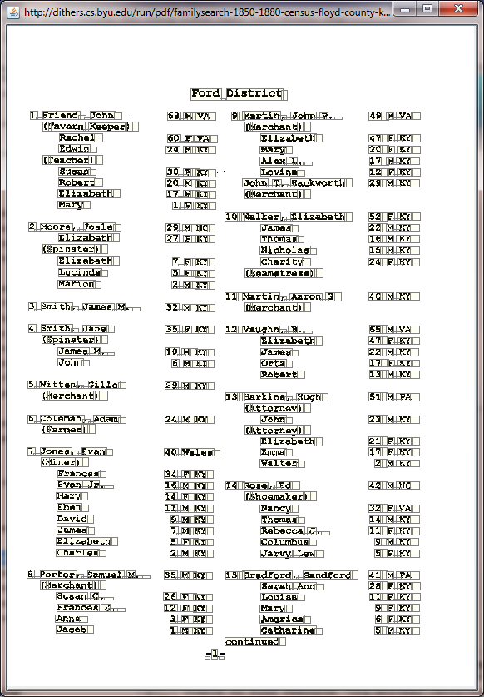
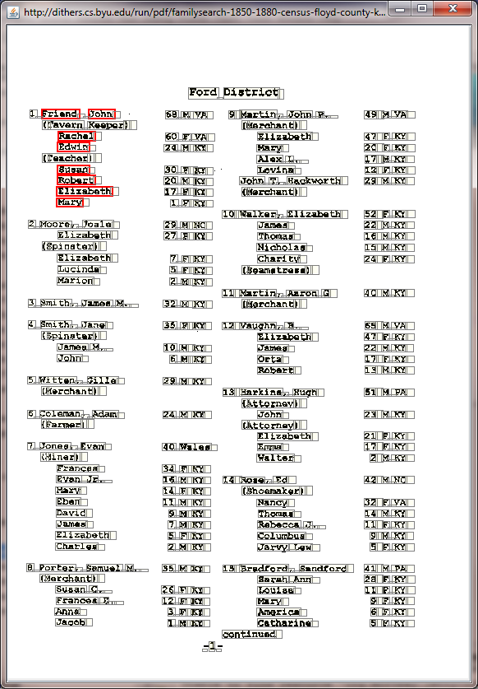
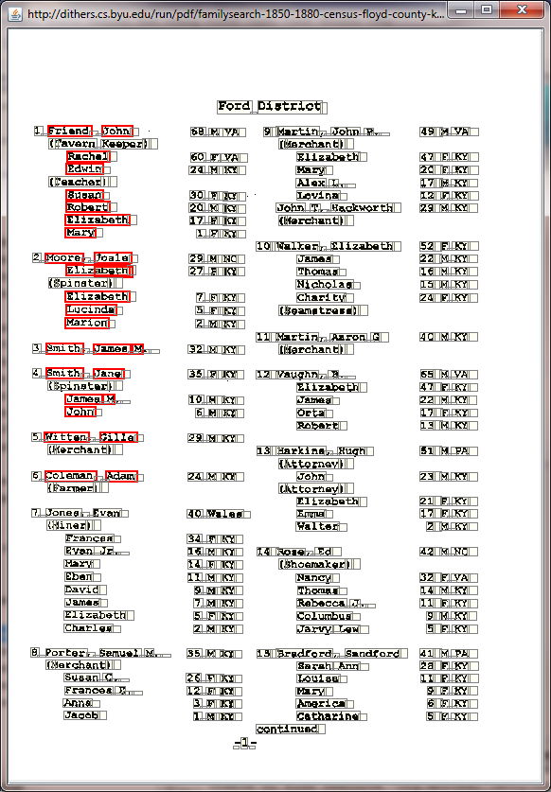
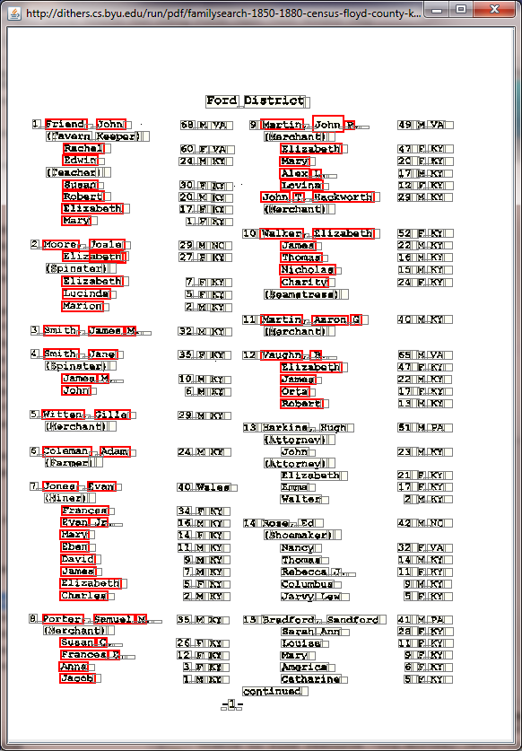
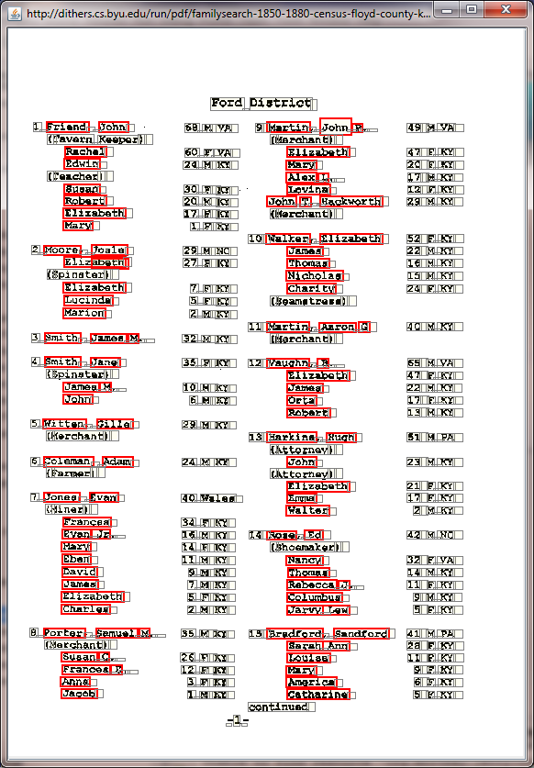
Simplified Evaluation System
Annotation
Evaluation
PDF+
PDF markup applet
Reference XML
1
2.
3.
Adobe Acrobat Professional
BYU Digital Collections
Other PDF sources
Eval-uation Tool
Test Results
SegmentationByLayout: AnnotatableImage3
http://dithers.cs.byu.edu/run/AnnotationPrototype.php?formName=PersonName (FireFox + Java 6)
Converter
Multi-page XML
OntoES
Output XML
SegmentationByLayout: DiscreteAreaEvaluator
OntosEvaluation: PdfProcessor
Needs multi-page support
(feed one page at a time)
Custom Reader / Writer
Name Extraction Ontology
To run this code:
SegmentationByLayout: edu.byu.deg.segmentation.layout.annotation.PdfAnnotationEditor
Arguments: http://dithers.cs.byu.edu/run/pdf/familysearch-1850-1880-census-floyd-county-kentucky-1860.pdf unused-parameter familysearch-1850-1880-census-floyd-county-kentucky-1860-gold.xml
Actual data/code sources are shown in yellow boxes
OntosEvaluation2: resource ontology/deg-name-extractor.xml

Slide 39
Summary
Vision
Implementation Status
Current and Future Projects

Slide 40
Credits
Ontology Editor – Numerous past students
Data Frame Editor – Numerous past students
Rule Editor – Nathan Tate
Hybrid Keyword and Semantic Search (HyKSS) – Andrew Zitzelberger
This presentation contains both actual screenshots and mock-ups of projected results

